Slide 1
Milestone 2:
Hotel Management System
System architecture
By
Edoardo Lenzi
Dominik Simon
Daria Shevkoplias
Patrick Tschuchnig

Slide 2
Use Cases

Slide 3
Use cases
Managing hotel rooms for small hotels and pensions
  Keeping track of bookings, arrival and
  departure times
  Handling customer reservations
Not planned
  Payment management
  Billing system will be manual – a staff member
  needs to confirm the payment by hand

Slide 4
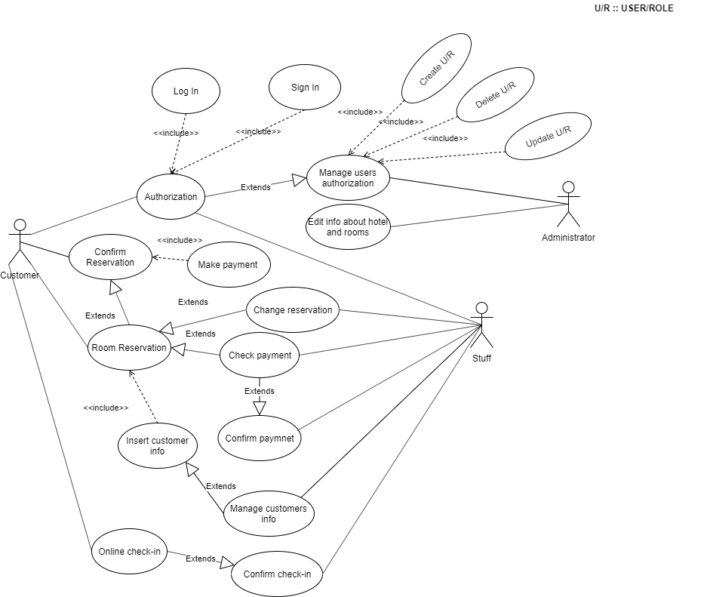
Use cases

Slide 5
System Architecture

Slide 6
System architecture - Overview
Dominik
Web-Frontend
Bootstrap
Jquery
JSON
REST
Middleware,
Controllers
Database
Management
odb
Business Logic
(Services)
Database
Patrick
Daria
Edoardo

Slide 7
Web-Frontend
Technologies
  Bootstrap Template as basis for the page
  jQuery for communication with the central software
Structure
  Landing Page
  Reservations Page
  User Registration Page
  Staff Management Interface

Slide 8
REST API
Standardised request format
  Containing an auth field with a SID
  And a Data field that is the actual request
            {
            "auth": {
            "sid":"<string>"
            },
            "[data]": {
            <custom json object>
            }
            }

Slide 9
REST API
Standardised response format
  Containing a status description, using standard HTTP status codes
  And a Data field that is the actual response
            {
            "status": {
            "code": "<num>",
            "description": "<string>"
            },
            "[data]": {
            <custom json object>
            }
            }

Slide 10
REST API
End Points
  /user (user operations)
    /register POST, no auth required
    /auth POST, no auth required
  /book (check and create bookings)
    /create POST, auth level: customer+
    /check POST, no auth required
  And others for roles, rooms, features, etc. tbd

Slide 11
Middleware
Takes care of every call
Authentication Handling
Parameter Checking
Sanity checks on REST calls

Slide 12
Controller
Takes care of specific calls
One for each Action via the API
Information exchange routines to communicate with the UI
Accesses the BL to gegt information needed for the DB (DTO)

Slide 13
Business Logic & Data Analysis
Analyses Data from the DB
DB Access Routines

Slide 14
Database Management
Providing Database Services to access Database Repositories exposing Entities
Interfacing with the sqlite DB based on our implementation of ODB
Adaptations have been done to provide new entities

Slide 15
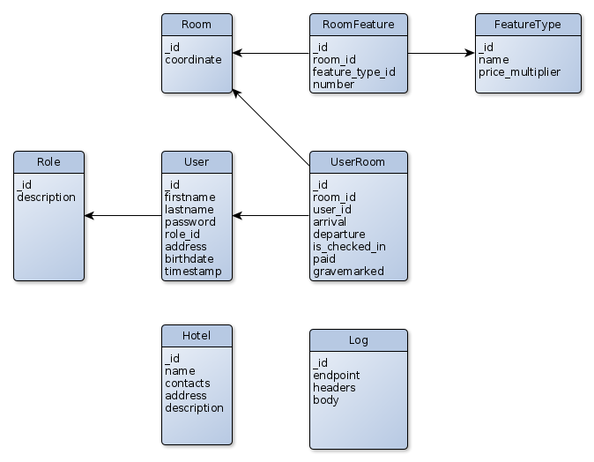
Database Structure

Slide 16
Users

Slide 17
Users & User Management
Users will be identified by RoleID
Roles are:
  Customer
  Staff
  Administrator
All Users will be kept in the same structure

Slide 18
Customers
Can login to the web interface (potentially making use of customer services that aren’t planned)
Will be able to create Bookings (UserRoom)
Can check-in by themselves

Slide 19
Staff
Can create and edit UserRoom elements
Manages Customer fields (Address, names, arrival and departure dates, check in confirmation)
Will take care of confirming the payment process (confirms the booking)

Slide 20
Admin
Full Access to manage Users and Roles
Can Create, delete, and update Users and Roles
Potentially can edit information about the hotel and the rooms

Slide 21
Thank you for your attention

Slide 22


This work is licensed under the DO WHAT THE FUCK YOU WANT TO PUBLIC LICENSE.

